Slide 1

Classical Conditioning
Classical Conditioning
Pavlov's Discovery
He discovered classical conditioning accidently while researching the process of digestion in dogs.
It was proposed by Ivan Pavlov ,a Russian physiologist interested in the study of gastric secretions.
He found that the sight or smell of the food or even the foot step of the attendant who bring food regularly was enough to start the dogs salivation.
Associative Learning-whenever two stimuli, events or objects occur together that tend to became mutually related or associated.

Slide 2
Elements of Conditioning
Unconditioned Stimulus (US)
Unconditioned Response (UR)
US is the stimulus that elicits the reflexive response (food).
The response to the unconditioned stimulus(salivation).
Conditioned Stimulus (CS)
Conditioned Response (CR)
Any neutral stimulus that when paired with an unconditioned stimulus acquires the property to elicit a similar response(Bell).
it is the response to the conditioned stimulus(Salivation).

Slide 3
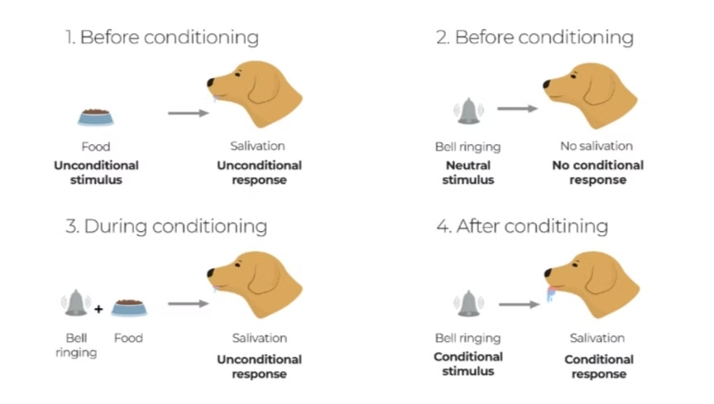

Slide 4
Extinction
Spontaneous Recovery
Stimulus Generalization
Decrease in frequency of a previously conditioned response.
The emergence of an extinguished condition to response after a period of rest.
A response to a stimulus that is similar to but different from a conditioned stimulus.

Slide 5
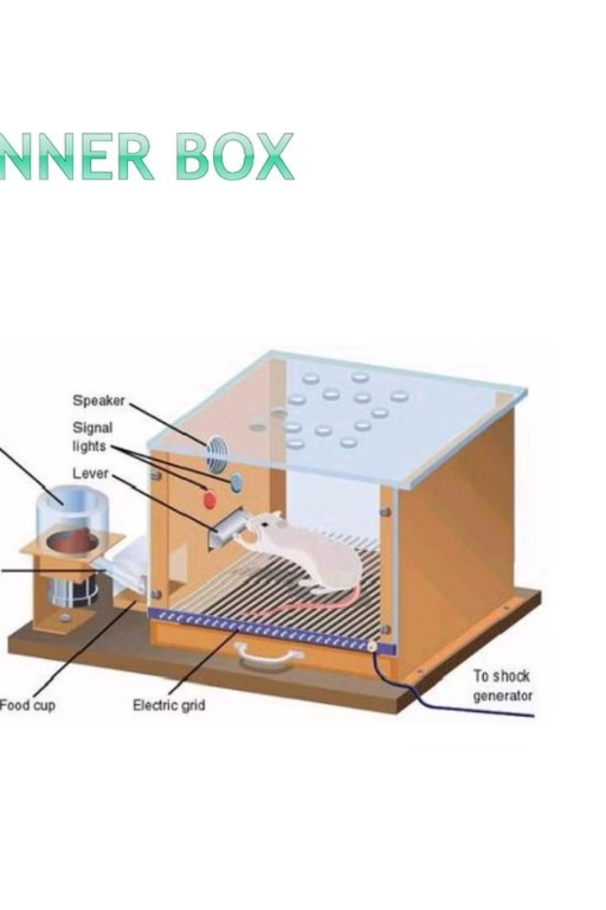


Operant Conditioning
Operant conditioning techniques was developed by BF Skinner.
The hungry rat began to find out the ways to get the food pellet and accidently pressed the liver which released the food pellets.
Skinner conducted an experiment on rat.
He used a box called skinner box where he delivered food pellets inside the box. Later he stopped feeding the rat.
After 4 or 5 trials of accidental pressing of the lever, the rat learnt to press the lever more rapidly.

Slide 6
1
Positive reinforcement-Adds something pleasant to encourage a behaviour.
Eg:-Teacher praise student for completing homework, then student will be more likely to repeat this behaviour in future.
2
Negative reinforcement-Removes something unpleasant to encourage a behaviour.
Eg:-If a person drive a car in overspeed, then he has to pay fine.so that person will drive more carefully next time to avoid paying fine and this strengthens the behaviour of keeping speed limit
3
Positive punishment-something is added that makes the behaviour discouraged or weak.
Eg:-Adding chores and responsibilities when he fails to follow the rules.
4
Negative punishment-something is taken away to make the behaviour discouraged or weak.
Eg:-Losing reward tokens: A third-grade boy yells at another student during class, so his teacher takes away his "good behaviour" tokens

Slide 7
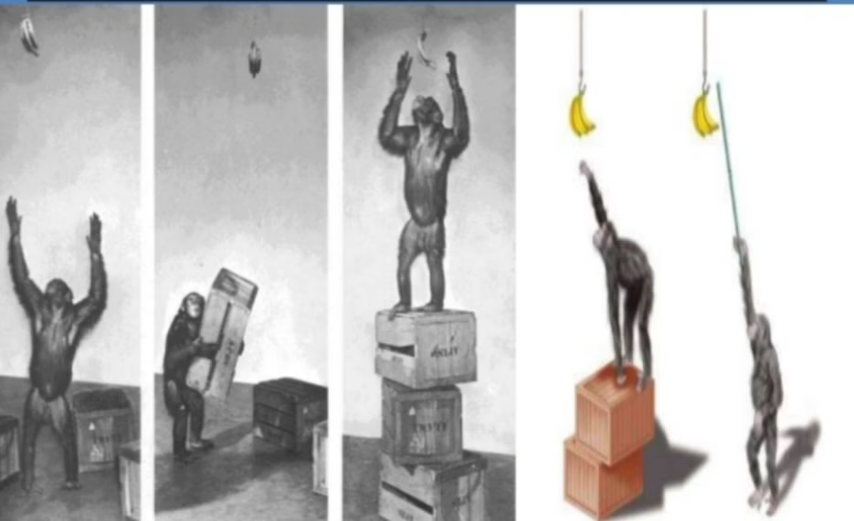
Insightful Learning
Insightful Learning
Proposed by Kohler ,according to him insight for learning occurs rapidly as a result of an understanding of all the components of a problem.

Slide 8
Latent Learning
Introduced to by E.C Tolman.
In Latent learning a new behaviour is learned but not expressed until reinforcement is provided.
Cognitive map is a mental representation of the locations.

Slide 9
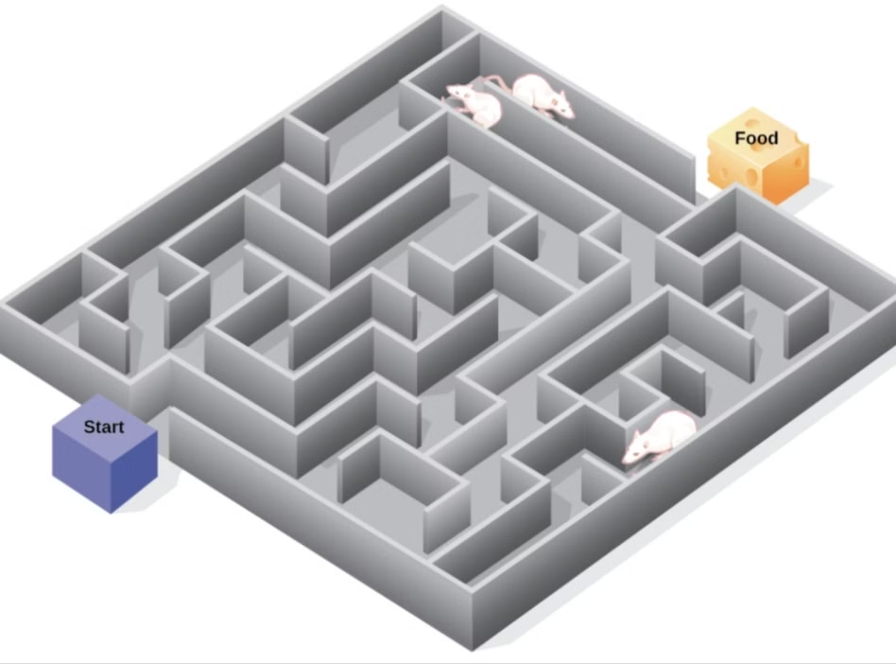

Slide 10





Factors influencing learning
1
Nature of Learner
2
Nature of learning material
3
Emotions and motivation
4
Physical and mental Health
5
Experience

Slide 11
Learning Process
Learning takes place if an individual behaves and responds in a way which is taken from other as a result of experiences.
3.Perception: The person learns things by visual, auditory or kinesthetic learning.
4.Response: May be negative, positive or neutral response.
The elements of learning process are:-
1.Goals: Desired outcome set by individual
5.Integration: Association of new behaviours with previously learned behaviours is related to transfer of learning.
2.Stimulus: The response is produced by the type of stimuli.

Slide 12
Habit Formation
A habit is a tendency of an individual to behave in the same way as he has behaved earlier.
Habits need no conscious attention to be repeated.
Habits are more applicable for motor activities.
Nature of habits
Habit is a simple form of learning.
Habits can be either good or bad.
It is an automatic response to a specific situation with least effort.
Habits provide economy to our lives.
Habits can be changed with intense motivation and conscious efforts.
Habit occurs as a result of learning and repetition.

Slide 13
The process of building habit can be divided into cue, craving, response and reward.
This pattern allows you to create automatic habits.
Example:- brushing the teeth: knowledge about it is the cue, to get a clean and refreshing mouth is the craving.
Cue triggers a craving, which motivates a response ,which provides a reward, which satisfy the craving.
Brushing the teeth is the response.
The reward is a clean mouth.

Slide 14

Memory
Memory is the special ability of our mind to conserve or store what has been previously learned or experienced to recollect or reproduce it after sometime.
According to Woodworth and Marquis, ‘Memory consist in remembering what has previously been learned.’
According to Ryburn, ‘The power that we have to store our experiences and to bring them into the field of consciousness sometime after experiences have occurred.

Slide 15

The three components of memorising processes are:-
Encoding- encoding is the process of converting sensory stimuli into a necessary form. Storage-process of holding information in memory. it can occur either in short term memory or long term memory.
Retrieval- process of recovering previously encoded information from the memory storage.

Slide 16
NATURE OF MEMORY
Memory is the special ability of mind to conserve what has been previously experienced or acquired through learning. memorizing is a complex process.
The process of memory begins with learning and ends with its retrieval and reproduction.
Memory involve learning or experience something, it’s registration, followed by retention and its recall.
Person with good memory can retain maximum amount of material.
Half learned material cannot be retained or reproduced properly in the mind.
Another sign of he capacity to bring forth the image or language for use in the present situation is a mark of good memory.
Clear and quick recognition is a sign of good memory.

Slide 17
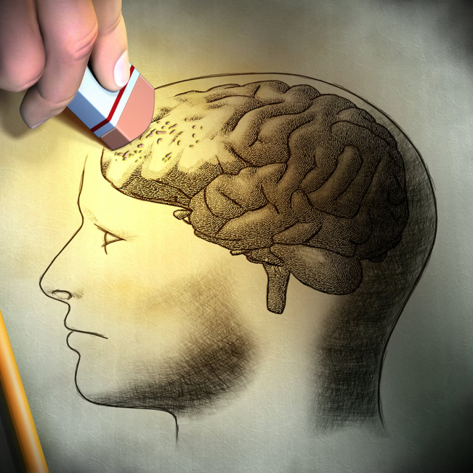
FACTORS INFLUENCING MEMORY
extrinsic factors
Stress-Increased levels of stress hormones affect the functioning of synaptic connection. Lose synapses make it difficult to retrieve memory.
Sleep-Good sleep helps to improve synaptic plasticity. Fatigue and minor damages due to day work are repaired during sleep.
Use of alcohol and drugs-Abuse of alcohol, tobacco and other addictive drugs impair memory. Smoking leads to accumulation of abnormal proteins in your brain and interferes with memory.
Distraction- greater the distraction present in the situation poorer would be the performance of the individual.

Slide 18
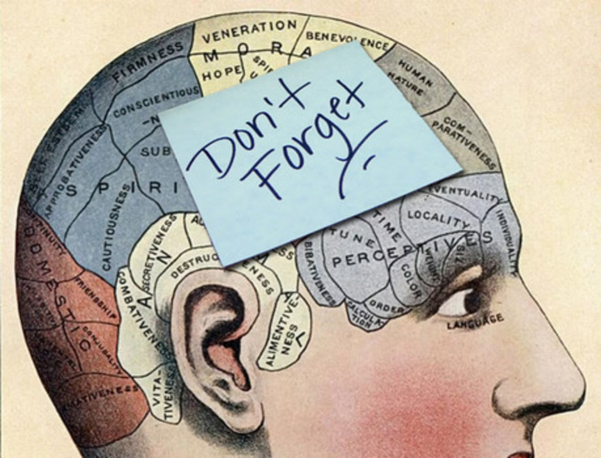
Intrinsic Factors
Age- Age can influence the capability of memory.
Maturity -very young children cannot retain and remember complex material.
Will to learn -material read, heard or seen without genuine interest is difficult to be remembered. 4)Interest- interest is essential for learning and memorization. 5)Intelligence- more intelligent person will have better memory than a less intelligent person. 7)Medical conditions- major causes for memory loss are contributed by medications.

Slide 19
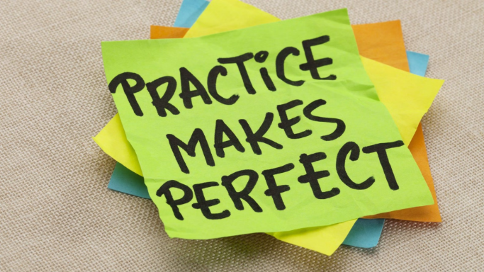
Methods to improve memory
Whole and part method
Whole method-Memorize the entire selection by repeating it continuously until you've mastered it.
Eg:-a poem, one is to read the poem again and again from the beginning till the end as a whole.
Part method-Break the selection into parts, memorize each part individually, and then connect the parts in the correct order.
Repetition and practice
Eg:-poem is divided into parts and each parts are memorized separately.
The things repeated and practiced are frequently remembered for a longer time in comparison to those for which little or no time is spend for repetition and practice.

Slide 20

Mnemonics
Methods for memorizing information by using patterns to make it more memorable.
1.Acronyms-Create a new word by combining the first letter or syllable of each word in a phrase.
Eg: VIBGYOR for remembering rainbow colous.
2.Chunking-Break information into smaller, more manageable groups.
3.Acrostics-used in the form ofa poem where the first letter of each word combine to form a message.
Eg:-Break a 10-digit phone number into three sets of numbers.
Eg:-to remember the planets in our solar system, you could use the acrostic "my very educated mother just served us noodles"

Slide 21
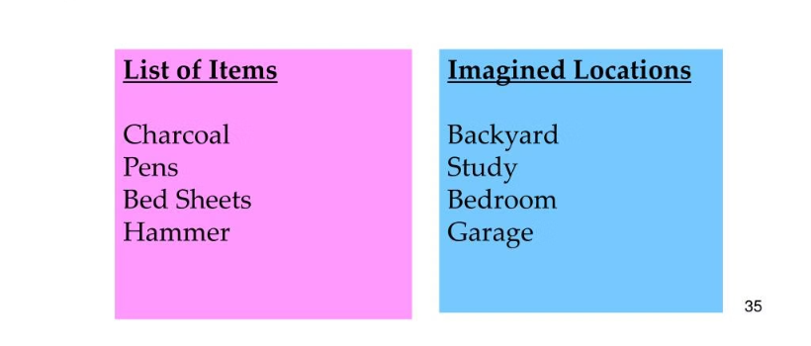
4.Keyword method- used to memorize a vocabulary that is difficult, then split the word and give meaning to the word after which you associate the new word to remember the old one.
Eg:-Word: Cataract
Keyword: Cat
5.Method of loci- link something which you want to remember with a place that you know very well.
Picture: A cat perched on top of rocks in a river and swiping at the water

Slide 22
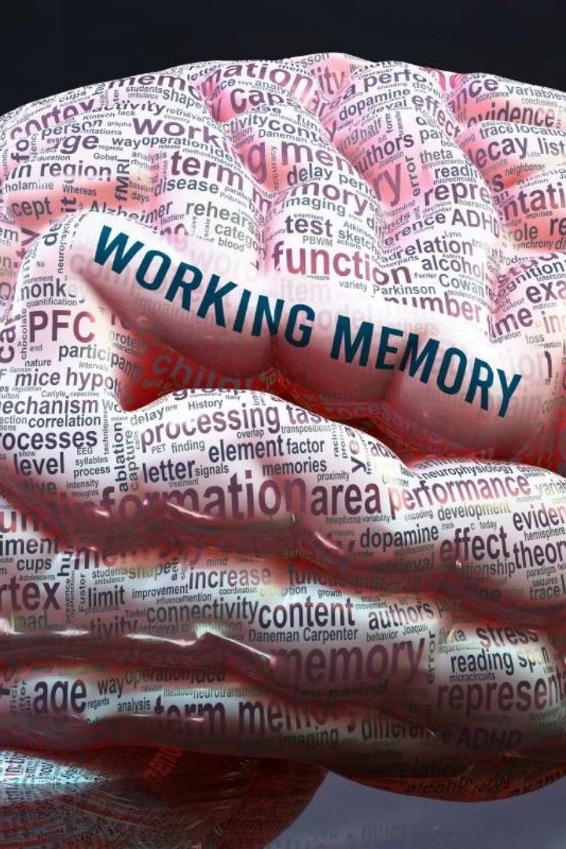
Types of memory
Sensory memory- the sensory memory is the entry area of memory which is considered as waiting room of memory.
The incoming information first enters the sensory memory. it has large capacity but only for a brief period of time. Short term memory- it is the intermediate memory process between sensory memory and long term memory.
Holds small amount of information for a brief period of time usually for 25 to 30 seconds. It is also called working memory. Hold only 7+or-2 items.

Slide 23

Long term memory- it is a permanent store house of all information and has a vast capacity.
The amount of information stored in LTM enables us to keep our personality and maintain our lifestyle.

Slide 24

Forgetting
Forgetting means a failure to recall a fact or Idea.
It is the weakening of the bonds that were formed in learning.
According to Munn, ‘forgetting is the loss, permanent or temporary ,of the ability to recall or reorganise something learned earlier.

Slide 25
TYPES OF FORGETTING
1.Natural forgetting Forgetting occurs with the lapse of time in a quiet normal way without any intention of forgetting on the part of the individual. 2.Morbid forgetting -Person deliberately tries to forget something (repression.) 3.General forgetting- one suffers a total loss in one’s recalling some previous learning. 4.Specific forgetting -the individual forgets only one or the other specific part of his earlier learning.
5.Physical forgetting-occurs when one loses his memory on account of the factors of age, malfunctioning of brain and nervous system, accidents etc.
6.Psychological forgetting- occurs when factors like stress, anxiety, conflicts and other psychological factors result in forgetting.

